Slide 1
Agile Development and DevOps
UNIT - I

Slide 2
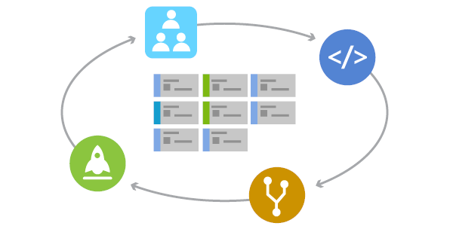
What is Agile?

Slide 3
What is Agile?
designed
designed
The Agile methodology is a project management approach that involves breaking the project into phases and emphasizes continuous collaboration, incremental deliver and improvement. Teams follow a cycle of planning, executing, and evaluating.
or
Agile is an incremental approach to software development that focuses on adaptation, collaboration, and delivering value to customers quickly.
The term Agile was designed in 2001 in the Agile Manifesto. The manifesto set out to develop principles to guide a better approach to software development

Slide 4
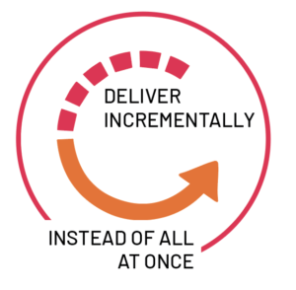
Why Agile?
In software development, agile practices involve finding out requirements and developing solutions through the collaborative effort of self-organizing and cross-functional teams and their customer/end user.

Slide 5
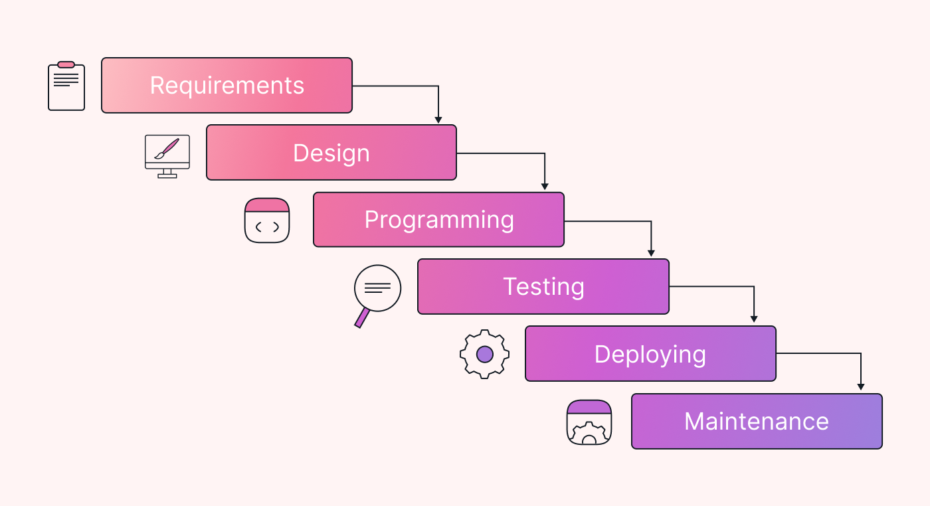
History of Agile

Slide 6
History of Agile
Two key opportunities were seen in order to overcome the traditional method of software development:
Shortening the delay of benefits to users in order to resolve the product-market fit and development problems.
Getting feedback from users quickly to confirm the usefulness of new software and continue to improve on it accordingly.

Slide 7
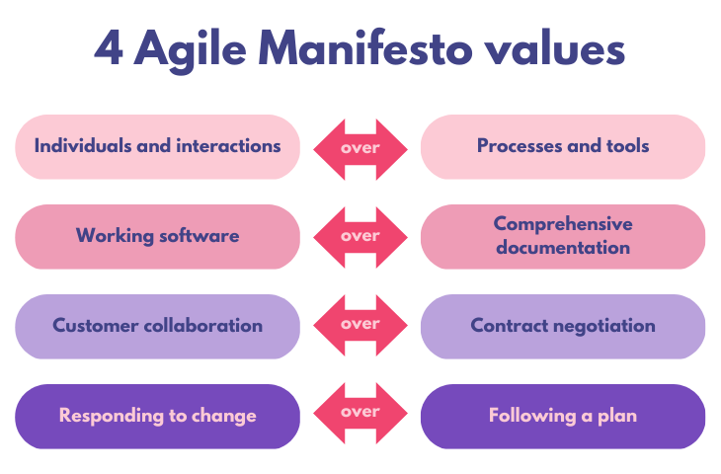
Agile Manifesto

Slide 8
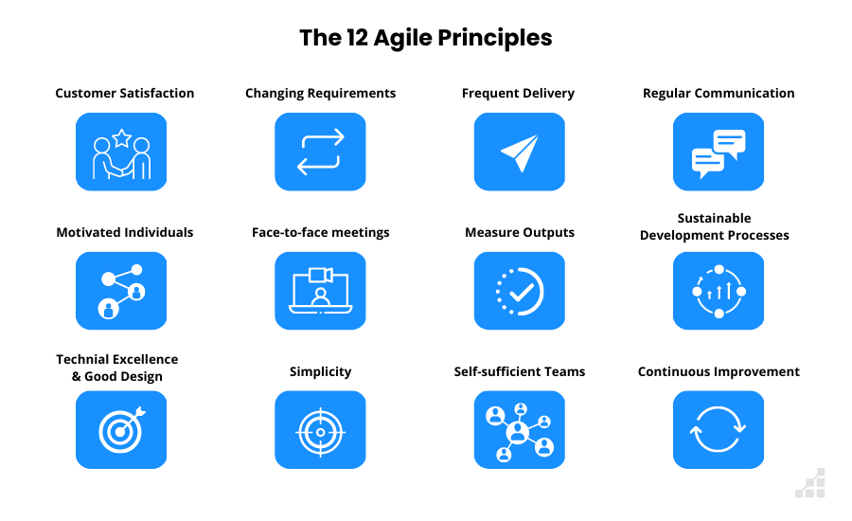
Agile Principles

Slide 9
Agile Principles
Satisfy customers through early, continuous improvement and delivery. When customers receive new updates regularly, they're more likely to see the changes they want within the product.
Welcome changing requirements, even late in the project. The Agile framework is all about adaptability.
Deliver value frequently. Similar to principle #1, continuous delivery of value to your customers or stakeholders frequently makes it like.
Break of your projects. Cross-functional teams and collaboration is a key Agile value. The goal is for people to break out of their individual projects and collaborate more frequently.

Slide 10
Agile Principles
Build projects around motivated individuals. Agile management works best when teams are committed and actively working to achieve a goal.
The most effective way to communicate is face-to-face. If you’re working on a distributed team, spend time communicating in ways that involve face-to-face communication like Zoom calls or daily stand-up meetings.
Working software is the primary measure of progress. The ultimate goal of software development projects is a working product, and the Agile framework supports this by functional software above all.
Maintain a sustainable working pace. Some aspects of Agile project management can be fast.

Slide 11
Agile Principles
Simplicity is essential. Sometimes the simplest solution is the best solution. Agile development aims to not overcomplicate things and find simple answers to complex problems.
Continuous excellence enhances agility. If the team develops excellent code in one sprint, they can continue to build off of it the next. Continually creating great work allows teams to move faster in the future.
Self-organizing teams generate the most value. Similar to principle #5, teams become valuable assets to the company as they to deliver continuous improvement.

Slide 12
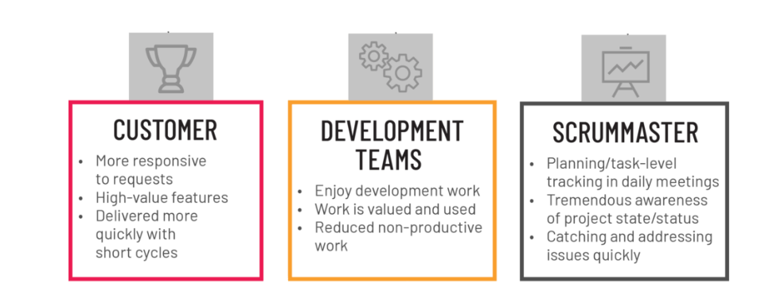
What are the benefits of Agile?

Slide 13
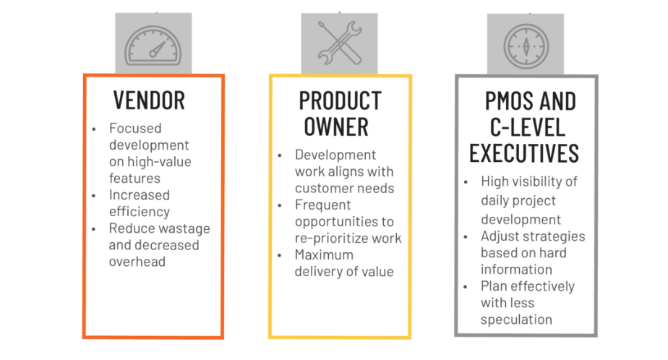
What are the benefits of Agile?

Slide 14
Agile Methodology
Agile methodology is a type of project management process, agile software development refers to a group of software development methodologies based on iterative development, where requirements and solutions evolve through collaboration between self-organizing cross-functional teams.
Agile methodology is a project management framework that breaks projects down into several dynamic phases
In 1957, people started figuring out new ways to build computer programs. They wanted to make the process better over time, so they came up with incremental methods.
In the 1970s, people started using adaptive software development and evolutionary project management.
This means they were adjusting and evolving how they built software. In 1990s, there was a big change. Some people didn't like the super-planned ways of doing things in software development.
They called these old ways "waterfall." So, in response, lighter and more flexible methods showed up.

Slide 15
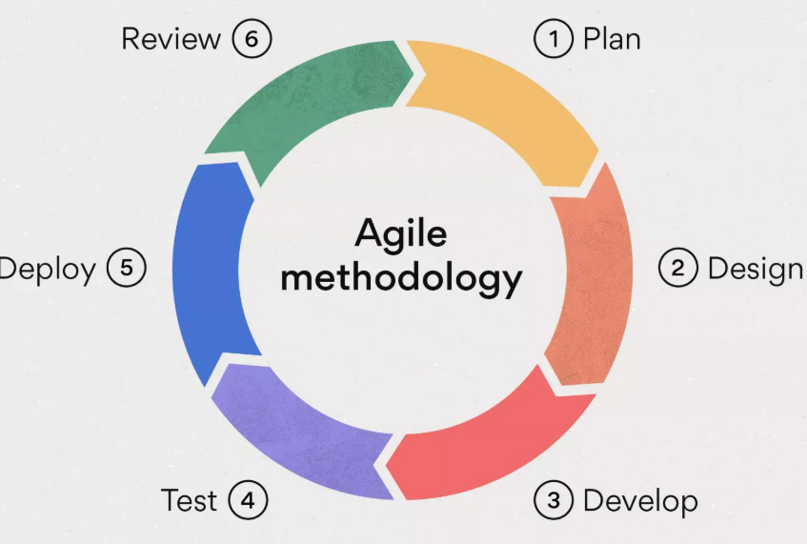
What is the Agile methodology?

Slide 16

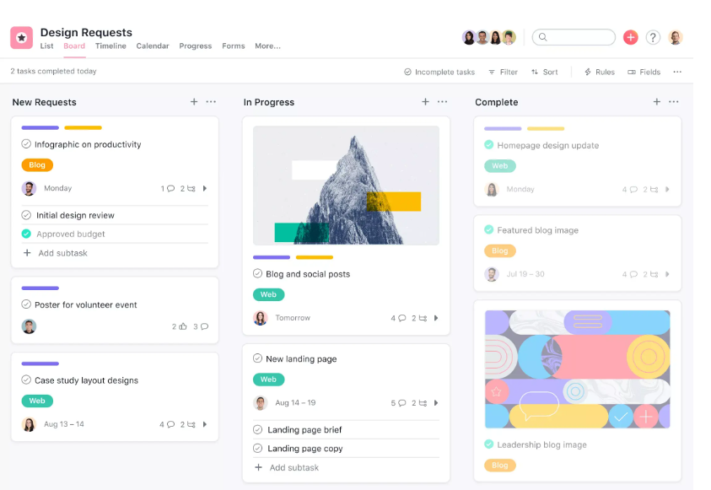
Kanban
Kanban is a method used to manage work visually. It uses a board (often called a Kanban Board) with columns like “To Do,” “In Progress,” and “Done” to show the status of tasks.

Slide 17
Scrum - The most popular Agile framework
Scrum is an Agile framework that helps teams collaborate and get high-impact work done. The Scrum framework provides a blueprint of values, roles, and guidelines to help your team focus on continuous improvement.
The Scrum workflow breaks large projects into smaller fragments that your team can work on quickly and iteratively. Because the Scrum process builds off of itself and encourages iterative repetition, you can use Scrum to continuously improve upon your deliverables until the entire project is completed.

Slide 18
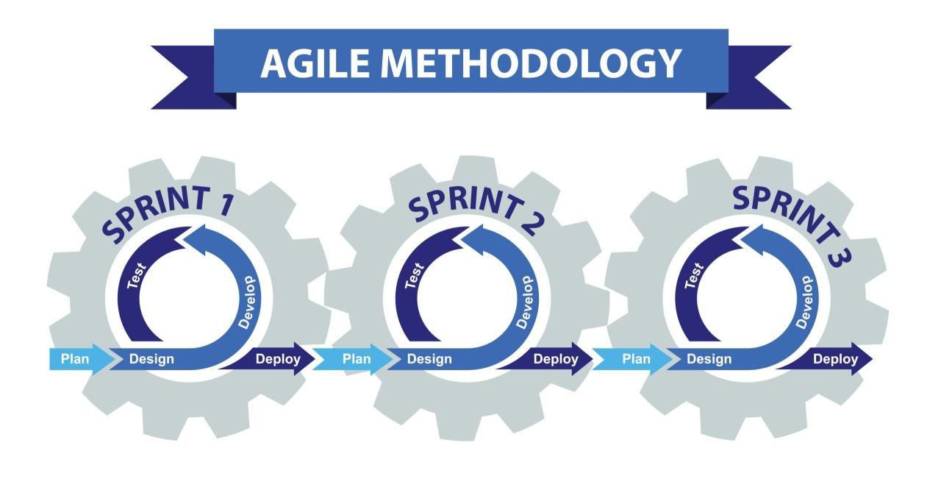
Agile Methodology

Slide 19
Extreme Programming (XP)
Extreme Programming (XP) is an Agile framework that outlines values that will allow your team to work together more effectively.
Communication
Simplicity
Feedback
Courage

Slide 20
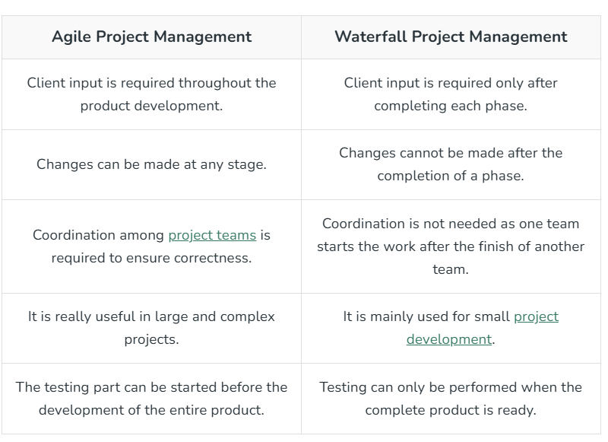
comparison between the Agile vs Waterfall Methodology

Slide 21
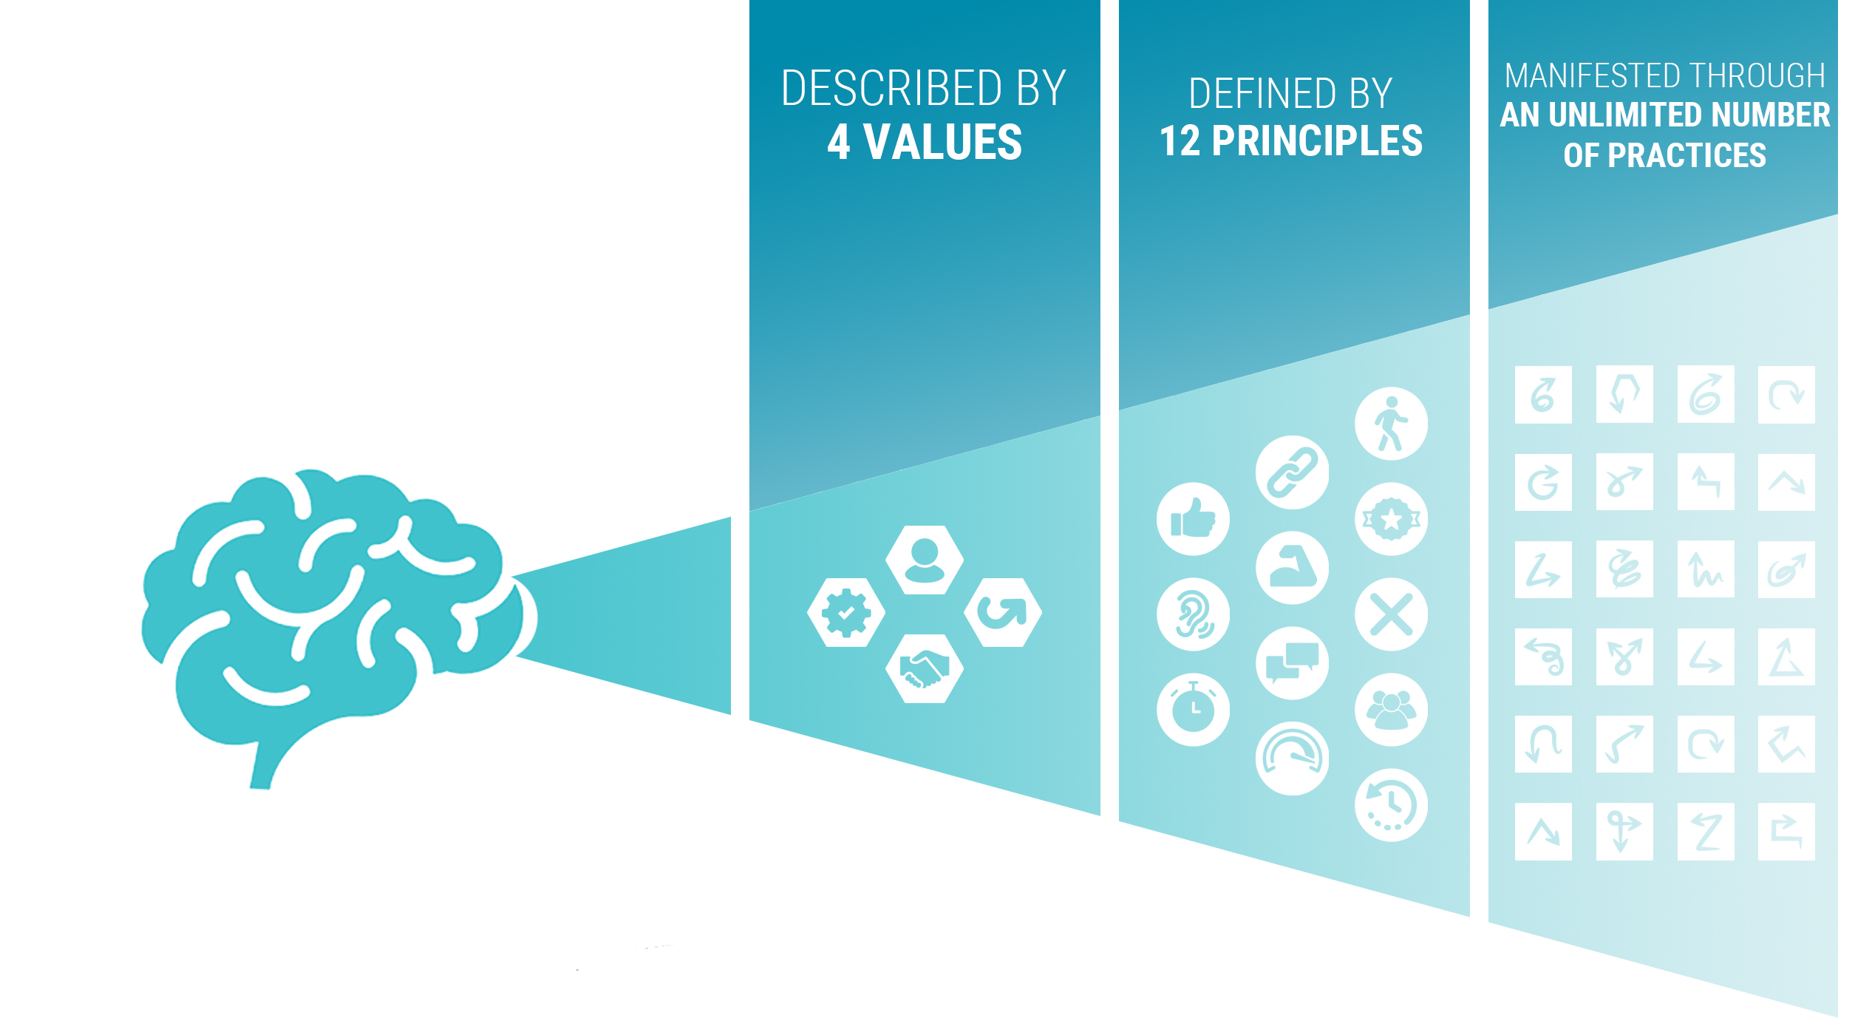
Agile Mindset

Slide 22
What Is An Agile Mindset?
In today’s fast-moving and constantly changing business world, old and strict corporate methods no longer work well. Companies need to be flexible and creative to keep up with changing customer needs and market trends. That’s why having an agile mindset is now so important.
An agile mindset focuses on “being agile” as a foundation for success in “doing agile.” It is defined by the four values and described by the twelve principles of the Agile Manifesto and then manifested through an unlimited number of practices and different ways of working.
The four values of the Agile Manifesto are the foundation of an agile mindset. In a world full of methodologies and frameworks

Slide 23
How to Develop an Agile Mindset
Continuous Learning
Experimentation and Innovation
Practice Adaptability
Collaboration and Communication
Adopt a Customer-Approach
Improve

Slide 24
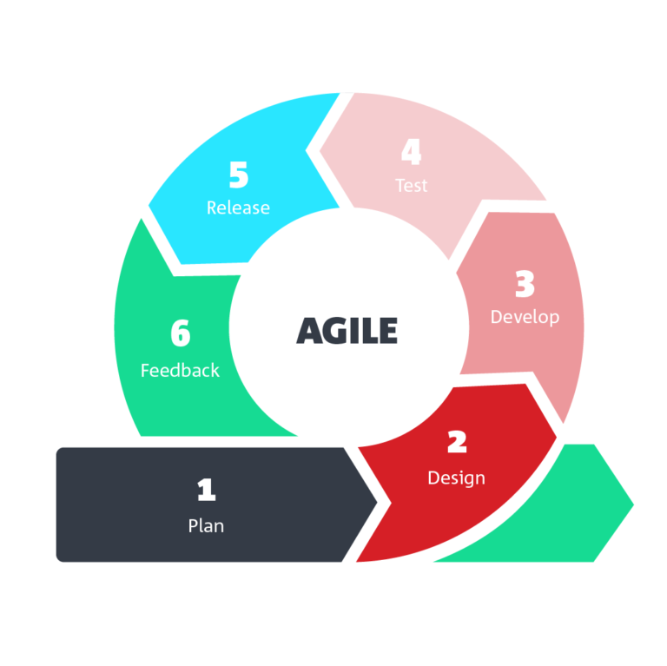
Agile Delivery
Agile delivery is an iterative approach to software delivery in which teams build software incrementally at the beginning of a project rather than delivering it all at once upon completion.
The key principles of Agile software delivery:
Collaboration
Customer focus
Value-based prioritization
Iterative development

Slide 25
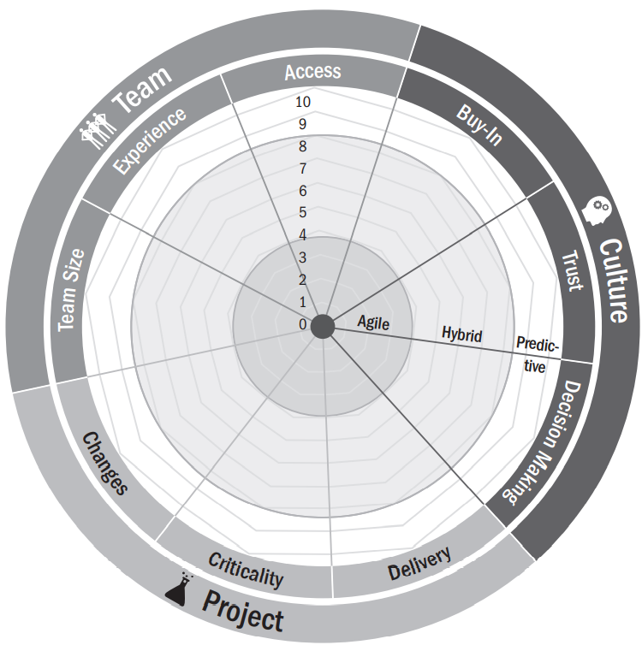
Agile Suitability
Agile practices offer a great way of monitoring and controlling product development cycles.
Agile allows product owners to adjust requirements and priorities along the way to take advantage of opportunities and ultimately deliver a better product to all the project stakeholders.
According to the Agile Practice Guide (2017)
These approaches use
Very short feedback loops
Frequent adaptation of process
Regularly updated plans,
and Frequent delivery.

Slide 26
Agile Suitability
Culture. Is it a supportive environment with buy-in for the approach and trust in the team
Team. Is the team of a suitable size to be successful in adopting agile; do its members have the necessary experience and access to business representatives to succeed
Project. Are there high rates of change Is incremental delivery possible
Life Cycle For Your Project
➟ Timeboxing
➟ User involvement
➟ incremental development.

Slide 27
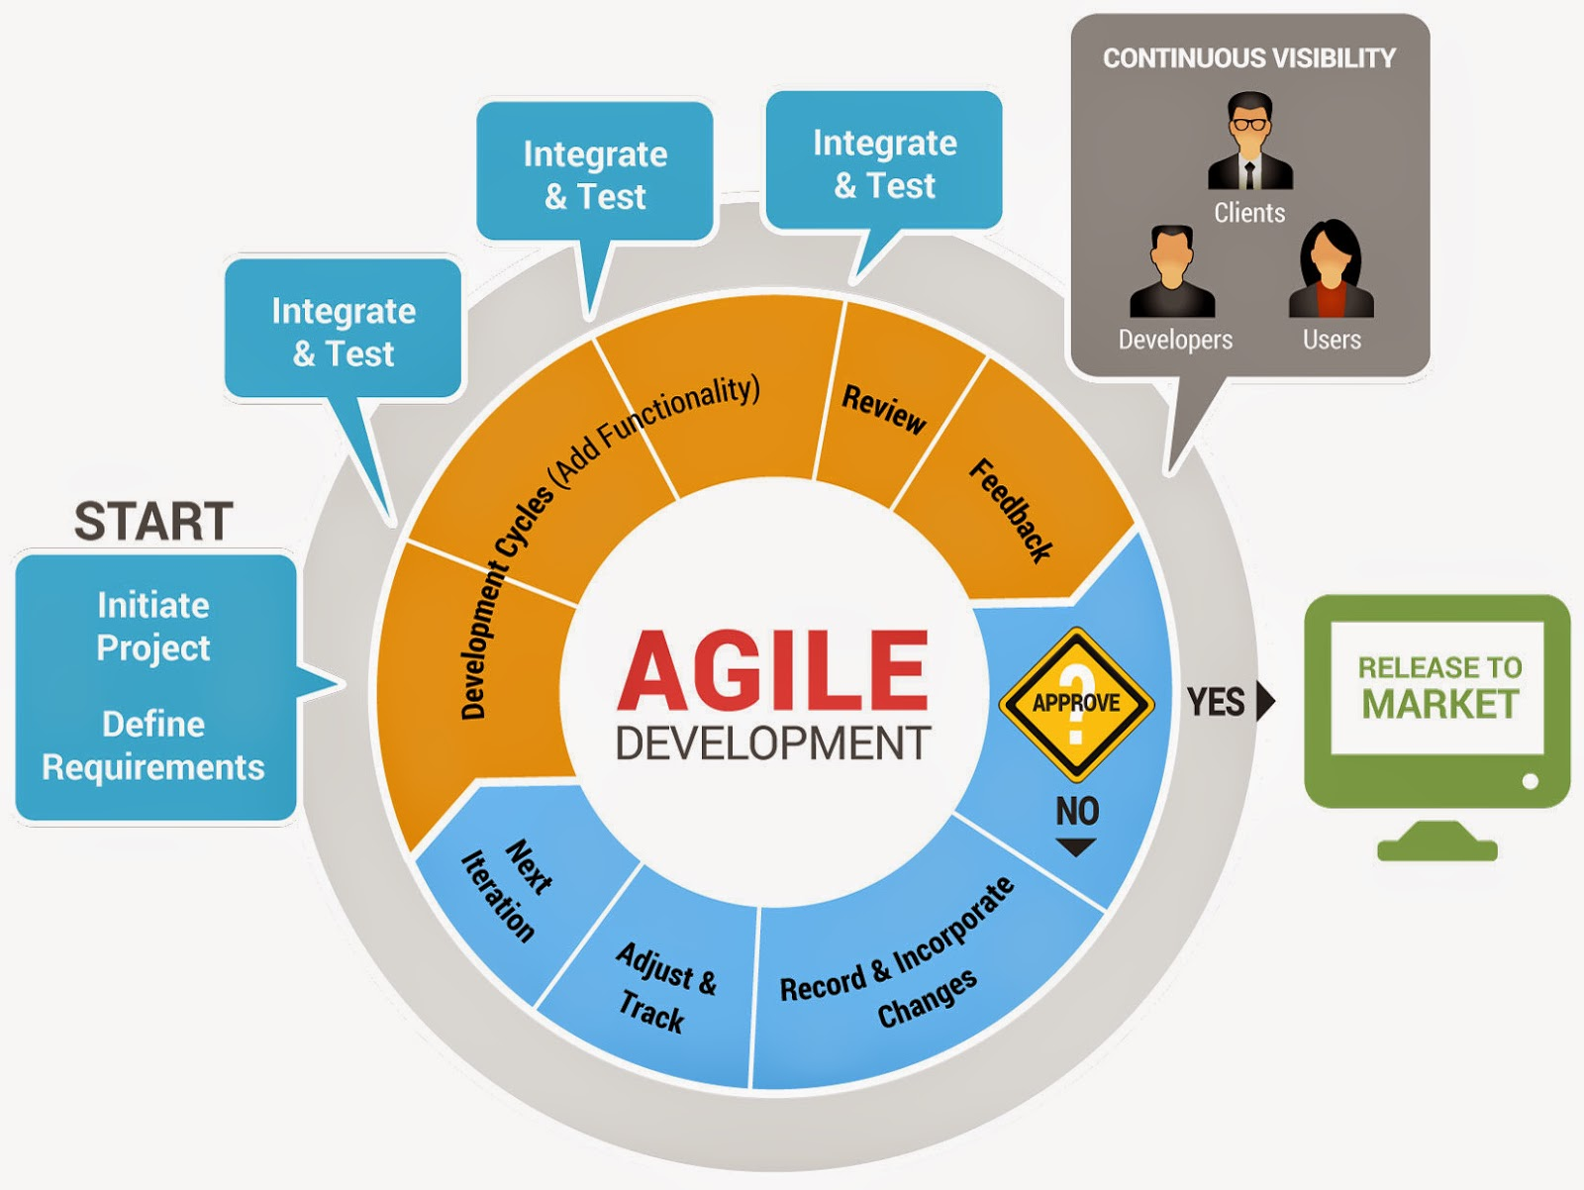
Agile Life Cycle Development

Slide 28
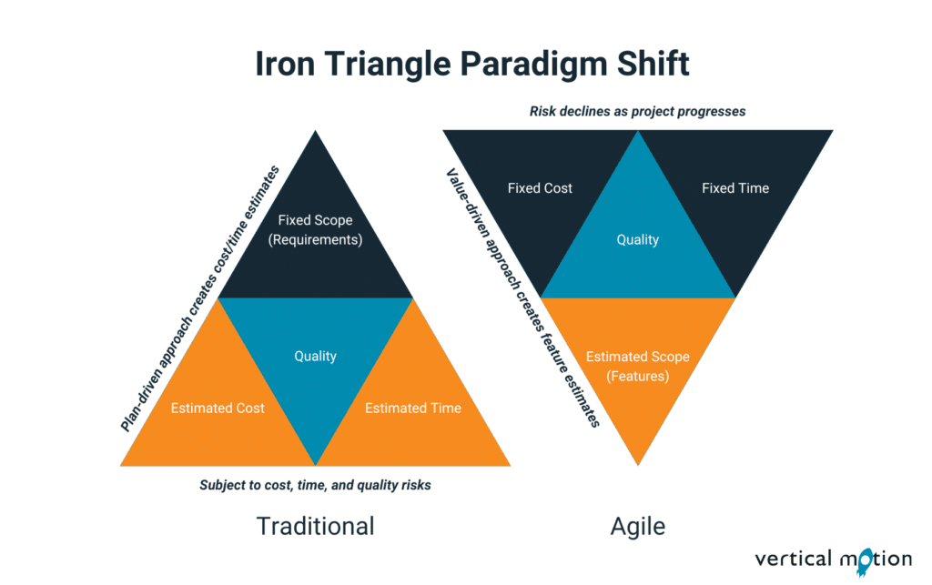
The Iron Triangle

Slide 29
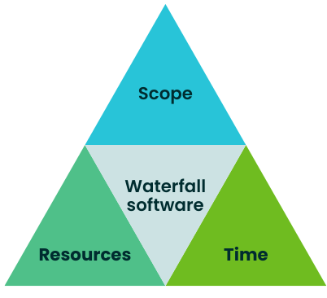
The Iron Triangle
The term "iron triangle" can refer to two distinct concepts: project management and US politics. In project management, it's a model representing the interconnected relationship between scope, time, and cost.
In US politics, it describes the relationship between committees, the Government agencies, and interest groups
The original iron triangle has three points: scope, resources, and time.

Slide 30
The Iron Triangle
Components:
Scope: The work that needs to be done to deliver a product or service.
Time: The project schedule, including deadlines and timelines.
Cost: The budget allocated for the project, including expenses for resources, materials, and labor.
US Politics Iron Triangle:
In US politics, the iron triangle refers to a specific type of policy-making relationship involving committees, the government agencies, and interest groups.

Slide 31
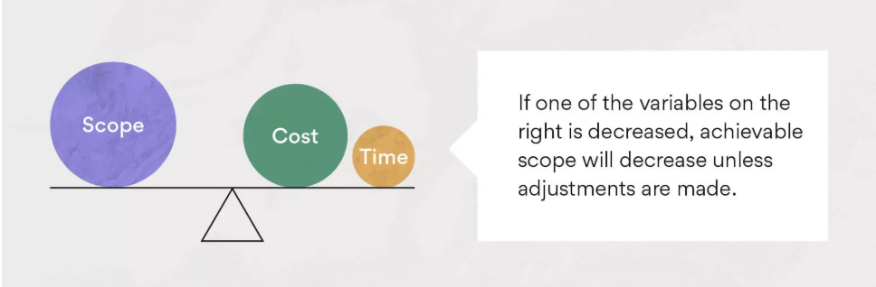
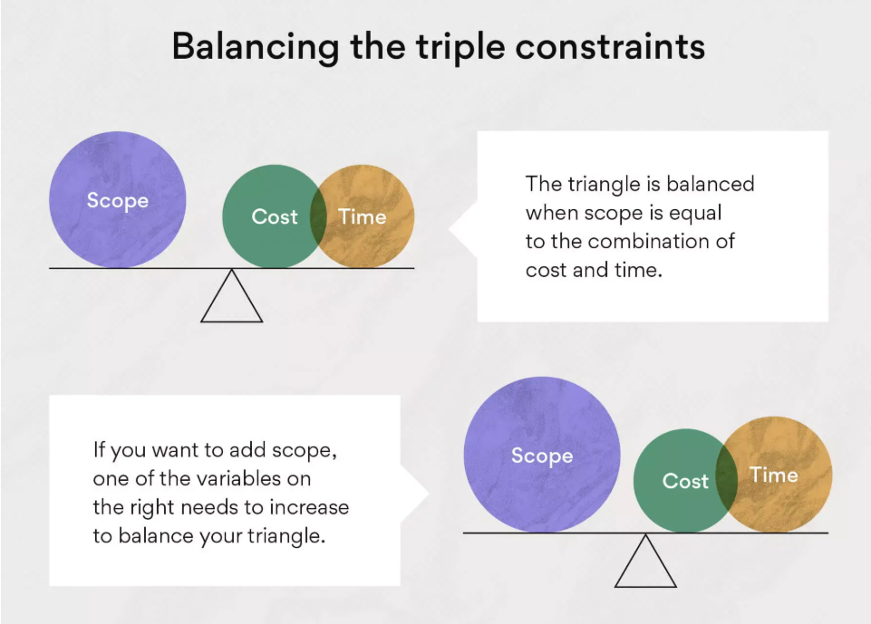
The Iron Triangle
There are two types of relationships at play in the project triangle. The first is the relationship between scope and the two other project variables. Scope is directly to both time and cost, which means it moves in the same direction as those factors. When scope increases, time and money must also increase in order to tackle a larger project.
The second type of relationship is the relationship between time and cost
In traditional methods, Scope is fixed, and Time and Cost are adjusted to complete everything
We must build all features, even if it takes more time or money

Slide 32
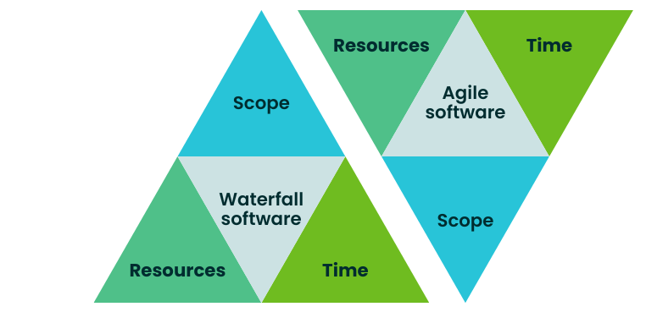
The Agile Project Management Triangle
saying “build me X and we’ll figure out how much time and resources it will require as we go” the Agile approach is built around “we have Y time and Z resources, so let’s figure out the most value we can deliver with them.”
In Agile, Time and Cost are fixed, and Scope is flexible based on what's most valuable to the customer.
“With this time and team, we’ll deliver the most important features first.”

Slide 33
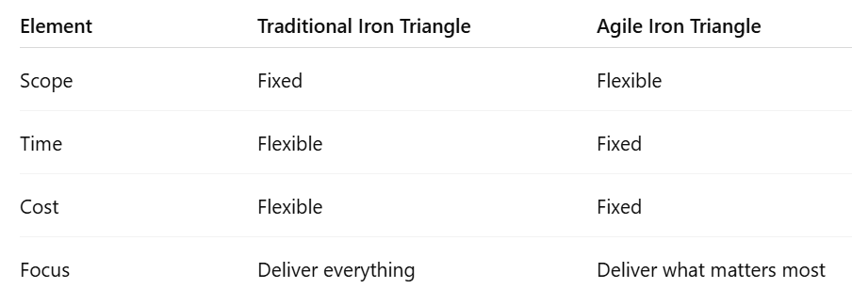
Iron Triangle vs Agile Iron Triangle

Slide 34
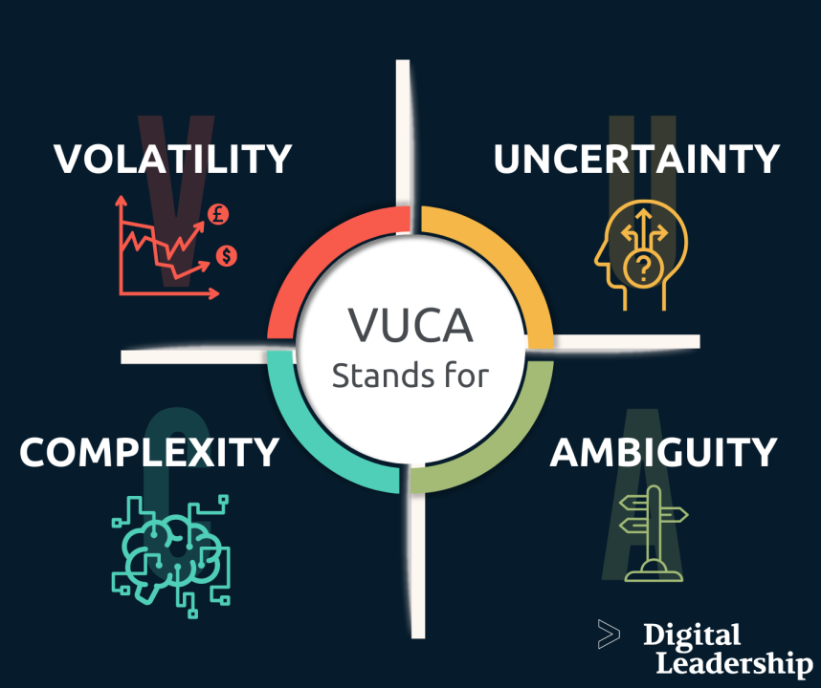
Working with uncertainty and volatility
Agile methodologies are well-suited for working with uncertainty and volatility by emphasizing iterative development, continuous feedback, and flexibility.
This approach allows teams to adapt to changing requirements and unexpected challenges, common in VUCA environments
by breaking down large projects into smaller, manageable pieces and continuously learning

Slide 35
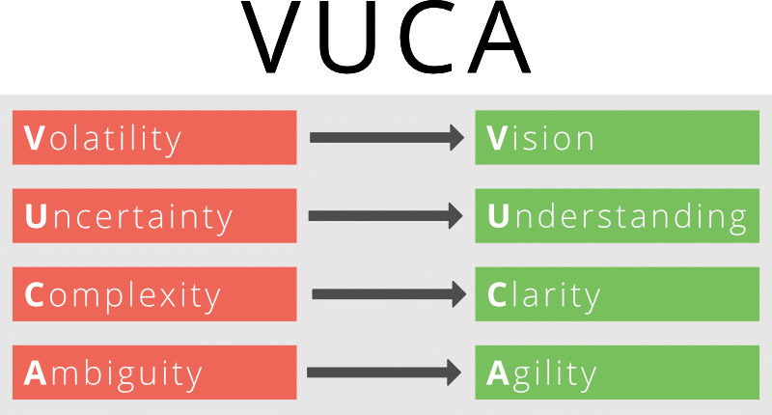
Working with uncertainty and volatility
Volatility:
Agile's iterative and incremental approach allows teams to respond quickly to rapid changes. By delivering working software in short cycles (sprints), teams can incorporate feedback and adjust their plans based on the latest information.
Uncertainty:
Agile methodologies encourage experimentation and learning through feedback loops. By developing gathering user feedback early and often.

Slide 36
Working with uncertainty and volatility
Complexity:
Agile promotes cross-functional collaboration and communication, which helps break down complex problems into smaller, more manageable parts.
Ambiguity:
Agile's focus on rapid prototyping and experimentation helps teams

Slide 37
Empirical Process Control (Agile Approach)
Feature | Description
🔁 Based on Experience | Decisions come from observation and feedback
👀 Transparency | Everyone can see the real progress
🔍 Inspection | Work is checked regularly
🔧 Adaptation | Plans are changed as needed
📌 Used In | Agile, Scrum, Kanban
Example: You build a small part, test it, learn from it, then improve in the next cycle.

Slide 38
Defined Process Control (Traditional Approach)
Feature | Description
📋 Predefined Steps | Process is planned in detail from start
🔒 Fixed Scope | Stick to original requirements
🛠️ Control-Oriented | Less flexibility to make changes
📌 Used In | Waterfall, traditional project models

Slide 39
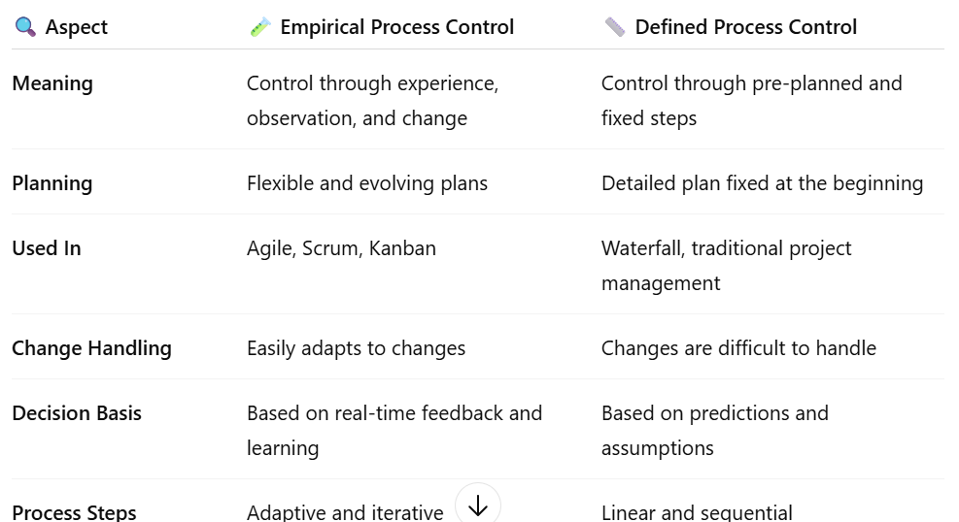
Empirical Process Control vs Defined Process Control
Empirical = Learn and adapt
Defined = Follow the fixed plan

Slide 40
Agile Design
Agile design is a highly collaborative way of design and developing new products that breaks big tasks into groups of subtasks to be performed in short ‘Sprints’. These tasks are regularly reported back to the virtual team in informal scrum meetings as a daily standups.
- Daily ‘Scrum’ Meetings (standing up)
- ‘Scrum Masters’
- Virtual Teams
- Visual project management (eg Kanban Boards)
- meetings to review and learn from sprints
- Charts.
- Prototyping: ‘Build-Measure-Learn’ development cycles

Slide 41
Agile Design
Agile design is a flexible and iterative approach that applies Agile principles to the design and user experience. This methodology comes from the Agile framework, which emphasizes adaptability, collaboration and customer feedback.
Why is Agile Design Important?
Agile design is a dynamic approach to design work that values flexibility, collaboration and customer feedback. It is valuable for UX (user experience) designers in various ways. This process integrates UX design in Agile methodologies and teams to quickly design projects in alignment with Agile development and UI/UX design principles.

Slide 42
Key Characteristics of Agile Design
Incremental: Agile design follows an iterative and incremental method, wherein the layout process is broken down into smaller chunks referred to as sprints.
Collaborative: Agile layout emphasizes collaboration between designers, builders, and stakeholders during the design manner.
Cross-Functional Teams: Agile layout involves cross-purposeful groups, in which designers, builders, and stakeholders with one-of-a-kind talent sets.

Slide 43
Agile Project Management
Agile project management is an effective methodology for managing projects in a fast-moving environment. It emphasizes collaboration, flexibility, and response to change, making it particularly suitable for global teams that face a range of complex challenges.
How to make agile project management to work effectively: - Foster Communication and Collaboration
- Define Roles and Responsibilities
- Establish a Common Language
- Cultural Differences
- Flexibility and Adaptability
- Use Agile Methodologies Appropriately
- Monitor Progress Closely

Slide 44
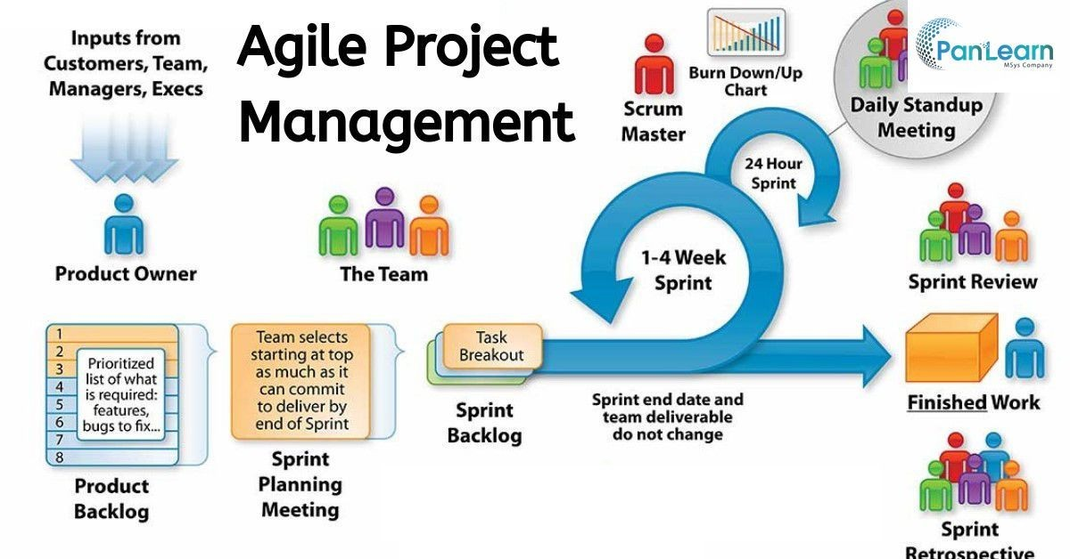
Agile Project Management

Slide 45
Generic Agile Framework
Generic Agile Framework: A Generic Agile Framework is a flexible structure based on Agile values and principles. It allows teams to adapt their process without strictly following a predefined method.
An agile framework is a specific approach of agile project management which incorporates elements of continuous planning, developing, testing, integration, and other forms of continuous development. Agile frameworks are lightweight compared to traditional development methods, which means that rules and practices are kept to a minimum for a rapid project development.

Slide 46
Popular Agile Frameworks
Kanban
Scrum
Lean Software Development (LSD)
Dynamic Systems Development Method (DDSM)
Feature Driven Development (FDD)
Adaptive Software Development (ASD)

Slide 47
Lean Software Development (LSD)
🚫 Reducing waste
🧠 Improving efficiency
🚀 Delivering value quickly to the customer
It comes from Lean manufacturing (Toyota Production System) and was adapted for software development.
Principles
Eliminate Waste, Build Quality In, Create Knowledge, Deliver Fast, Respect People,

Slide 48
Dynamic Systems Development Method
DSDM is an Agile project management and delivery framework that focuses on speed, collaboration, and business value.
It was one of the first formal Agile methods and is often used for large-scale business projects.
Principles of DSDM:
Focus on business need, Deliver on time, Collaborate, Never compromise quality, Build incrementally from firm foundations

Slide 49
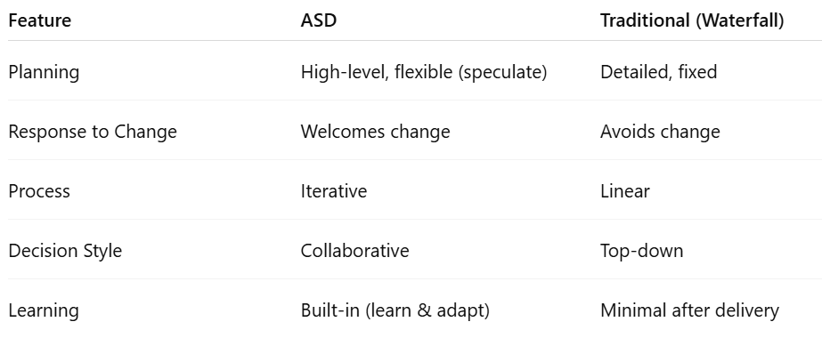
Adaptive Software Development (ASD)
Adaptive Software Development helps teams deal with uncertainty and change by planning lightly, working together closely, and learning continuously.
It’s especially useful for complex projects where things can change often

Slide 50
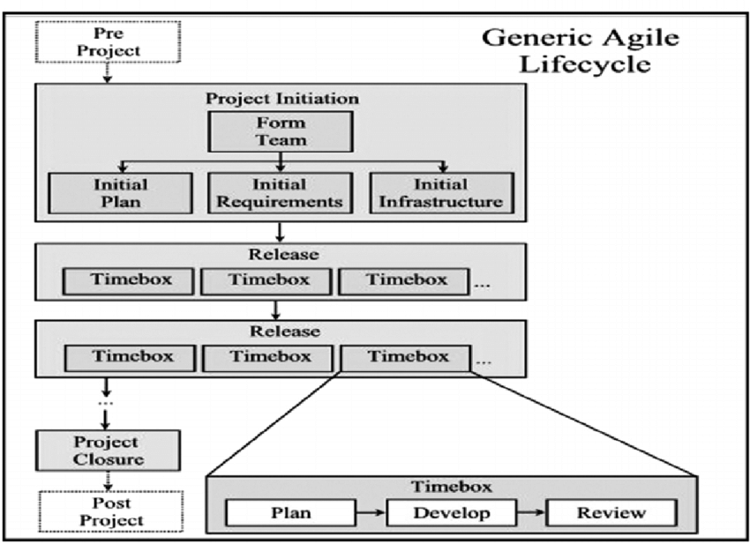
Generic Agile Process

Slide 51
Common Agile Roles
Different Roles involved in Agile Process:
1. Customer/Product Owner
2. Project manager
3. Project Lead/Agile Lead/Scrum Master
4. Team
5. Stakeholders

Slide 52
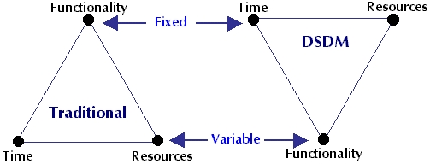
Major Agile Frameworks
Dynamic System Development Method or DSDM: - DSDM is a long-standing approach that’s been used successfully since 1994 for software development and delivery.
- With its iterative and incremental approach, it was agile well before the Agile Manifesto was written and went a lot further than the team level, making it an agile scaling methodology (not just a framework) long before the term ‘scaling agile’ was coined.
- DSDM is an Agile method that focuses on the full project lifecycle, DSDM focus is more governance and discipline to this new iterative way of working.

Slide 53
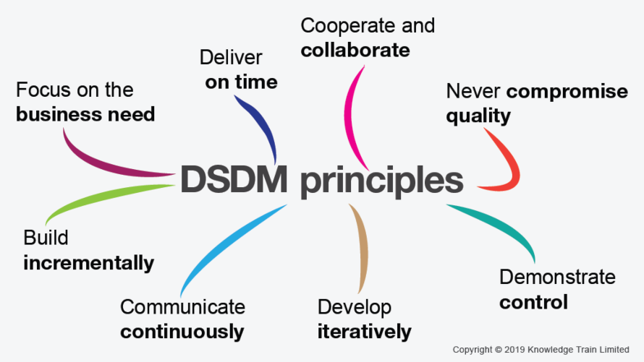
DSDM Principles

Slide 54
1. Focus on the business need
DSDM users believe that a business case must be made for the project before any development can begin. The team must have total, crystal-clear comprehension of the project’s priorities so that each decision helps to achieve the defined goals.
2. Deliver on time
As an agile framework, DSDM works with fixed timeboxes and iterations to create a product. There is a strong emphasis placed on prompt delivery to help control changing requirements
3. Collaborate
Collaboration is crucial to the success of DSDM. Teams should work as a singular unit to create quality products.
4. Never compromise quality
For agile teams, streamlining processes and avoiding waste is crucial. DSDM follows that same principle but reminds us to never sacrifice quality. To adhere to this principle, DSDM teams must continuously test and review their work

Slide 55
5. Build incrementally from firm foundations
DSDM differs from other agile methods as it requires the foundations of the project to be established early. The foundations don’t need to have too much detail, just enough to define the problem and how you intend to solve it.
To do this, DSDM teams perform analysis and ‘ design up front’ at the start of the project
6. Develop iteratively
As with other agile methodologies, teams using the DSDM agile framework will build the product incrementally to ensure maximum value
7. Communicate continuously and clearly
At every stage of development, DSDM teams need to be transparent. This is enabled through daily stand-ups, sprint reviews, and prototyping.
8. Demonstrate control
DSDM was created to give product managers more control over their projects. PMs can demonstrate control by ensuring that all progress is visible, and progress is measured by deliverables.

Slide 56
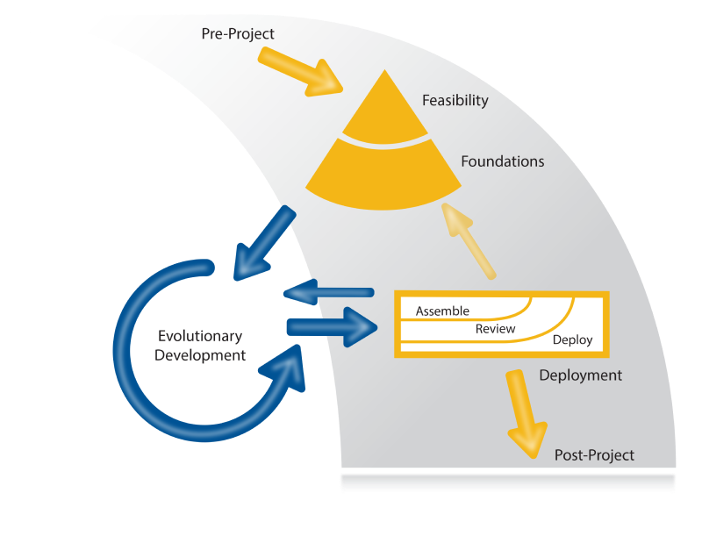
DSDM Project Phases

Slide 57
DSDM Project Phases
Pre-Project: phase ensures that only the right projects are started, and that they are set up correctly, based on a clearly defined objective.
Feasibility: phase is intended primarily to establish whether the proposed project is likely to be feasible from a technical perspective and whether it appears cost-effective from a business perspective.
Foundations: is to understand the scope of work, how it will be carried out, by whom, when and where. The Foundations phase also determines the project lifecycle by agreeing how the DSDM process will be applied to the specific needs of this project.
Evolutionary development: Working within Timeboxes, the Solution Development Team create Solution Increments, iteratively exploring the low-level detail of the requirements and testing continuously as they move forward.
Deployment: The objective of the Deployment phase is to bring a baseline of the Evolving Solution into operational use.
Post-Project: After the final Deployment for a project, Post-Project phase produces one or more Benefits Assessments for these realized benefits in relation to the business case.

Slide 58
KANBAN
Kanban is a highly visual work management method, developed in Japan in the late 1940’s by Toyota engineers.
The word Kanban roughly translates in Japanese as “visual card”.
It is closely associated with Lean.
By displaying cards on a board, a team can easily display a workflow to everybody involved in the team.
The fundamental benefit of working in this way is that any disruptions to workflow are easily identified, and team members can collaborate to rectify issues before they get out of control.

Slide 59
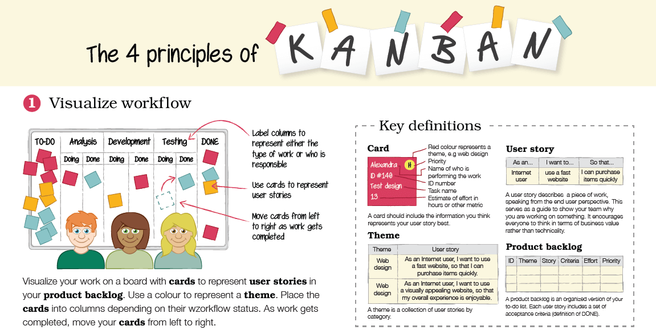

Slide 60
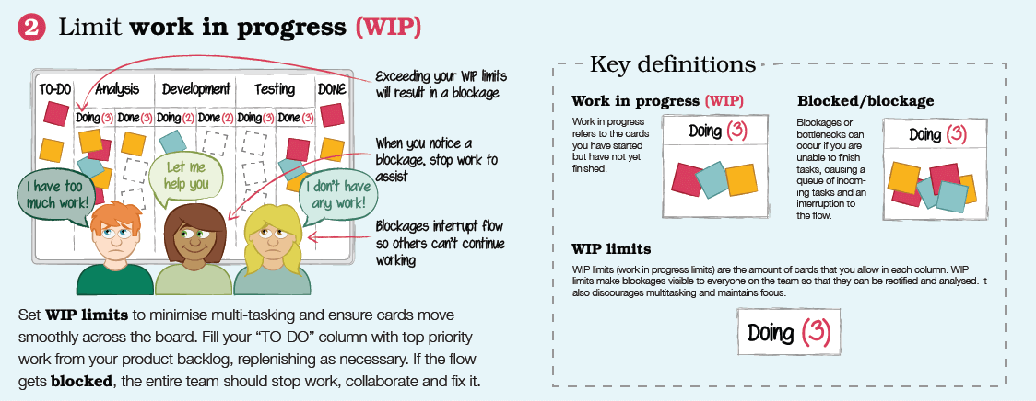

Slide 61
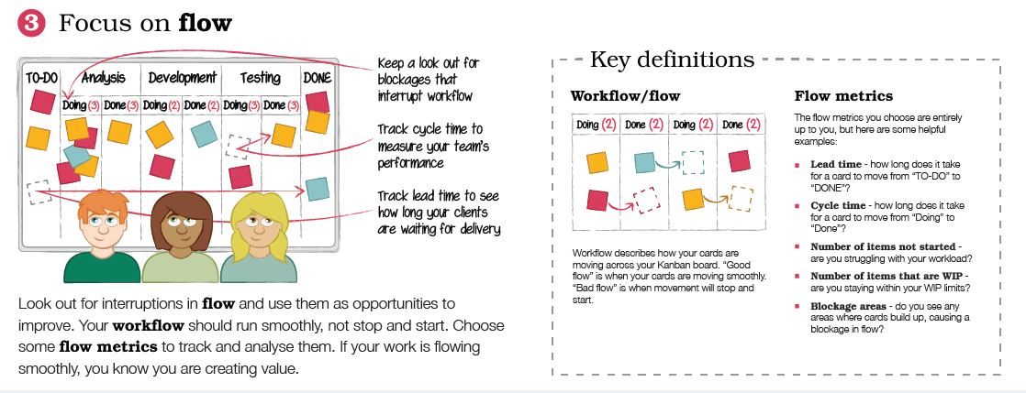

Slide 62
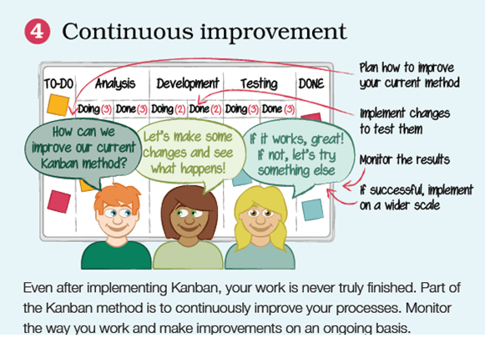

Slide 63
1. Visualize workflow
Visualize your work on a board with cards to represent user stories (work) in your product backlog (inventory). Use colours to represent the theme of your user stories. For a simple Kanban board, label one column “TO-DO” and another “DONE”. Label columns in between “TO-DO” and “DONE” to represent either the type of work or whoever is responsible for undertaking it.
2. Limit work in progress (WIP)
Set a limit on how much work can be in progress at one time in each column. In other words, how many cards can be in each column at a given time. This ensures that cards are moving smoothly across the board as and when the team are ready for them.
Do the top priority work first
Your “TO-DO” column should be filled with top priority work from your product backlog. When you have a space in your “TO-DO” column, you can fill it with another user story from your product backlog. By setting work in progress limits (WIP limits), the entire team can quickly see if there is a blockage and collaborate to fix it.

Slide 64
3. Focus on flow
By now, your work should flow freely through the Kanban system. It might even feel very easy! Make sure that you keep a lookout for any interruptions in flow and use these as opportunities for improvement. Workflow should run smoothly and not stop and start. Choose some flow metrics to track and analyse them. Which ones you choose are entirely up to you, but here are some helpful examples:
Lead time - how long does it take for a card to move from “TO-DO” to “DONE”?
Cycle time - how long does it take for a card to move from “Doing” to “Done”?
Number of items not started - are you struggling with your workload?
Number of items that are WIP - are you staying within your WIP limits?
Blockage areas - do you see any areas where cards build up, causing a blockage in flow?
4. Continuous improvement
Remember that even after implementing Kanban, the work is never truly finished. Part of the Kanban method is to continuously improve your processes. Monitor your Kanban system and make improvements on an ongoing basis

Slide 65
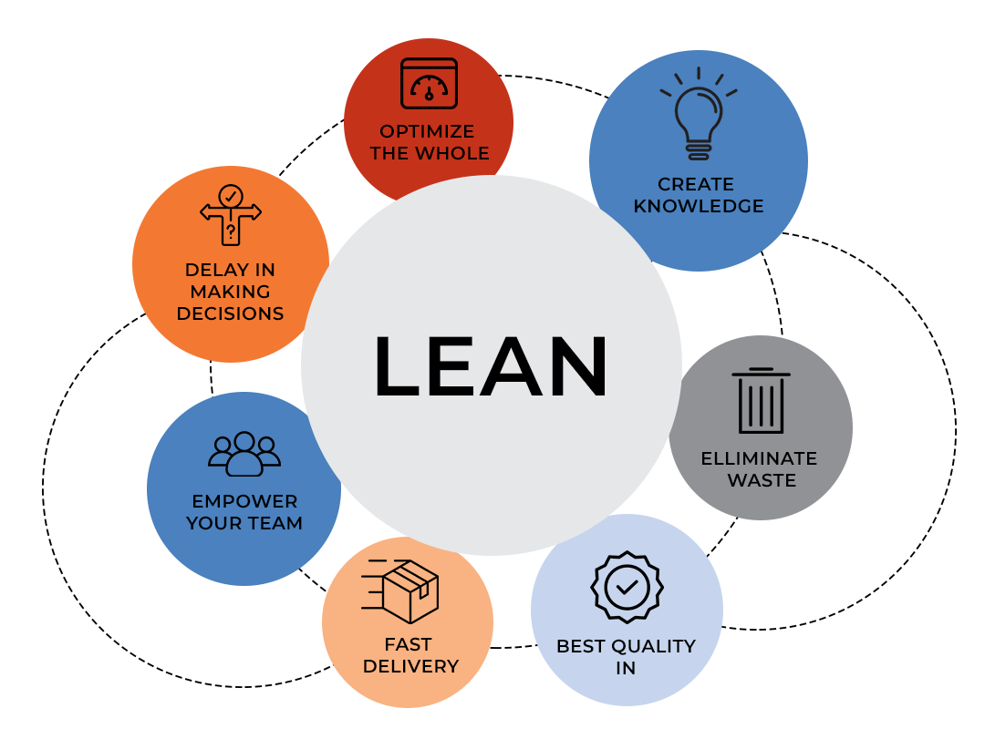
Lean Software Development (LSD)
LSD is an Agile framework that had been by Toyota — the Japanese automotive giant - at the beginning of the 20th century.
Lean software development is a emphasizes on optimizing efficiency, development time and minimizing waste in the software development and manufacturing process which results in maximizing value to the customer.

Slide 66
Build Quality
Various lean development tools are used in lean and agile development to ensure quality is maintained all along the process. Some of the most popular lean development tools for quality building are:
Pair programming – software engineering method combines the skills and experience of two developers instead of one. Each task is carried out by two developers, which helps figure out more effective solutions and deliver better quality of work.
Test-driven development – tests are written before writing the code so that the engineer can ensure it meets business requirements.
Incremental development and constant feedback
Minimize wait states – lower context switching, knowledge gaps, and focus loss
Automation – manual process are prone to human error is automated

Slide 67
Create knowledge
Pair coding
Documentation
Code reviews
Well commented code
Training
Knowledge sharing sessions
Wiki knowledge base system

Slide 68
Deliver fast
Problems with deployment decisions are:
Thinking and planning too far in advance
Not responding quickly and effectively enough to the blockers
Over-engineering of both business requirements and their solutions

Slide 69
Optimise the whole
- Development, testing, and operations are all connected in how they influence each other up and downstream in the software development process.
- Lean software development teams recognize the need for the whole to be optimized and unified to achieve the purpose.

Slide 70
Empower Team
Communicating proactively and effectively
Encouraging constructive difference of opinion to avoid group thinking
Tackling any work-related issues any team members have as a team
Empowering each other to do their best work

Slide 71
Lean start-up Framework
The lean startup methodology is used to develop products and businesses in a short period of time, which allows the creator of the product or business to quickly determine if their business model is a viable one.
The goal of using this methodology is to get rid of wasteful practices during the initial stages of a company, which provides the company with a higher possibility of long-term success.

Slide 72
Why Lean Start-up
The fundamental activity of a startup is to turn ideas into products, measure how customers respond, and then learn whether to pivot or persevere. All successful startup processes should be geared to accelerate that feedback loop.
“The Lean Startup method teaches you how to drive a startup, how to steer, when to turn, and when to persevere and grow a business with maximum acceleration”.

Slide 73
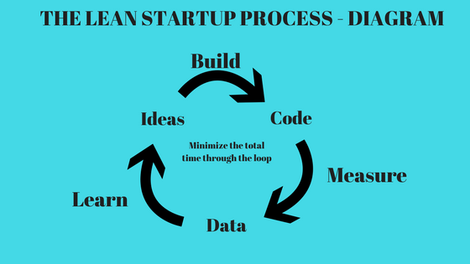

Slide 74
SAFe (Scaled Agile Framework)
The Scaled Agile Framework (SAFe) is a set of organizational and workflow patterns for implementing agile practices at an enterprise scale (level).
The framework is a body of knowledge that includes structured guidance on roles and responsibilities, how to plan and manage the work, and values to uphold.
SAFe collaboration, and delivery across large numbers of agile teams. It was formed around three primary bodies of knowledge: agile software development, lean product development, and systems thinking.

Slide 75
Core Values - SAFe
Alignment
SAFe (Scaled Agile Framework) says that companies should plan and reflect regularly at every level.
When this happens: Everyone knows what's happening now Everyone knows the goals Everyone knows how to work together to reach those goals
By meeting and working together often, everyone stays on the same page and moves in the same direction.
2. Built-in quality
According to SAF, there are five key dimensions of built-in quality: flow, architecture and design quality, code quality, system quality, and release quality.

Slide 76
3. Transparency
SAF encourages trust-building behavior, including planning work in smaller batch sizes so problems can be surfaced sooner, providing real-time visibility into backlog progress across levels
4. Program execution
Program execution is the heart of SAF and powers everything else in the framework. Teams and programs must be able to deliver quality, working software and business value on a regular basis.
5. Leadership
SAF requires lean-agile leadership behavior because only leaders can change the system and create the environment necessary to embrace all of the core values.

Slide 77
SAFe Principles
The Scaled Agile Framework’s principles are meant to improve the company by inspiring lean-agile decision making across functional and organizational boundaries.
1. Take an economic view
SAFe says that everyone in the company should: Do the most important work first
Understand cost vs. benefit
Use money with lean budgets
2. Apply systems thinking
SAFe encourages people using the framework to apply systems thinking to three key areas: the solution itself, the enterprise building the system, and the values. Solutions can refer to products, services, or systems delivered to the Customer, whether they are internal or external to the Enterprise

Slide 78
3 Assume variability; preserve options
When designing systems or software, there’s always some uncertainty. This principle suggests that instead of choosing one solution too early, it's better to keep multiple ideas and options open for a longer time. This approach is called set-based design.
4. Build incrementally with fast, integrated learning cycles
Similar to Principle #3, this principle addresses risk and uncertainty through learning milestones. It is not enough for each component part of the system to prove functional; the whole system must be considered to assess the feasibility of the current design choices. Integration points must be planned on a regular cadence to accelerate faster learning cycles.
5. working systems
Demonstration of an actual working system provides a better basis for decision making than a requirements document or some other superficial evaluation of success.
6. Visualize and limit Work in Process (WIP), reduce batch sizes, and manage queue lengths. Limiting work in process helps stakeholders see exactly how work is playing out.
7. Decision making
Reducing queue lengths and taking an economic approach by decentralizing decision making, gives teams the autonomy they need to get work done

Slide 79
Symptoms of Poor Design in Agile
Hard to change things – Even small changes take a lot of time, Changing one part breaks another part.
Confusing code – Code is not clear, New people can’t understand it easily.
Same code in many places – Copy-paste code everywhere, If you fix one place, you have to fix all.
Too many problems (bugs) - App crashes or gives errors often, Fixing one bug creates another. Team works slowly – More time fixing problems than making new features.
No testing or bad testing – Code is not tested properly, – Hard to know if it works.

